Slide 1
Count Parking Lots
Li Xu
Tianzheng Huang
Dept. of Computer Science, University of Missouri,
Columbia, MO 65211, USA
Digital Image Processing Final Project
Wed Dec 16th , 2015, 5:00 pm

Slide 2
Outline
Motivation and Background
Image Processing Tasks and Goals
Algorithm and Implementation Details
Results: Demo and Evaluation
Summary and Future Work

Slide 3
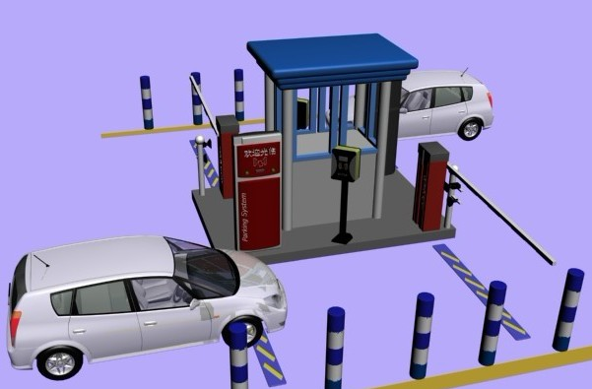
Motivation and Background
More and more people have private car, and find an available parking lots is harder than before.
The traditional way to check whether the parking area is full or not is arranging a sensor at the entrance of the parking location.
Disadvantage : costly and not efficient.

Slide 4
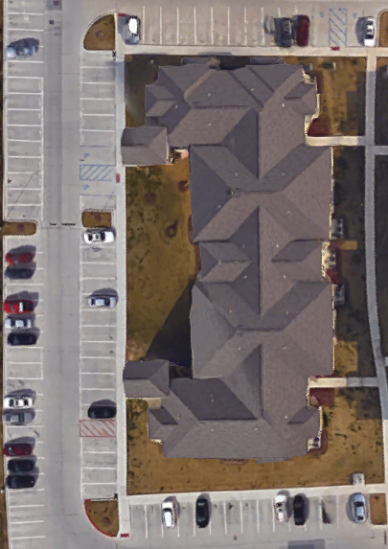
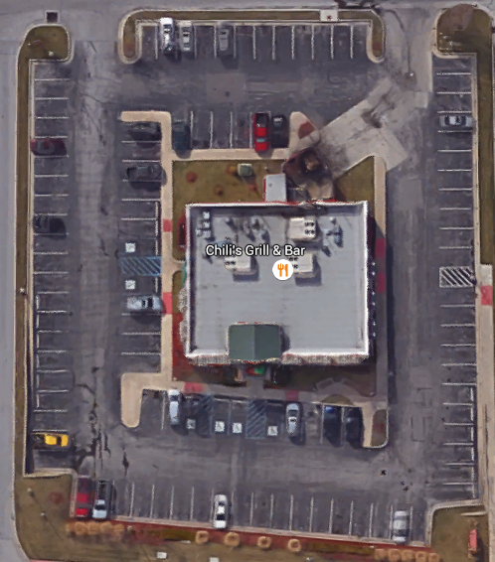
Image Processing Tasks & Goals
Here are sample images, come from Google Map
Sample 1
Sample 2
Sample 3

Slide 5
Image Processing Tasks & Goals
We totally have 7 steps to achieve our parking lot detection.
Step1: using sobel filter to get Gx, Gy edge detection image.
Step2: using connected component label to get all connected area.
Step3: first time remove noise. (the threshold is [20, 200]).
Step4: record each line’ s information. (leftmost_x1, rightmost_x2, highest_y1, lowest_y2)
Step5: second time remove noise (remove not line-shape spot).
Step6: keep the parking line and remove other line-shape but not the parking line noise.
Step7: count number of Gx and Gy image parking lines.

Slide 6
Algorithm and Implementation Details
Step1: Sobel filter edge detection: Because the parking lots in the picture have different direction : horizonnl(Gx) and vertical(Gy)
Step2: Connected component label: Because we need use the parrallel line to be standard line. And use it to get special information and contrast other noise line.
Step 3: Get each lable size and set a threshold [20. 200], first time remove noise.

Slide 7
Algorithm and Implementation Details
Whetherlabelx (to check if the label has got its beginning point)
label | 0 | 1 | ...... | n
ischecked(0/1) | 0 | 0 | ....... | 0
Recordlabelx
 | label | 1 | ....... | n
1 | Mostleft(X1)
2 | Mostup(Y1)
3 | Mostright(X2)
4 | Mostdown(Y2)
5 | Width(X2-X1)
6 | Hight(Y2-Y1)
7 | CenterX(X1+X2/2)
8 | CenterY(Y1+Y2/2)
9 | Ischecked(0/1)
10 | Isline(0/1)

Slide 8
Label information
Recordlabely
 | label | 1 | ....... | n
1 | Mostup(Y1)
2 | Mostleft(X1)
3 | Mostdown(Y2)
4 | Mostright(X2)
5 | Hight(Y2-Y1)
6 | Width(X2-X1)
7 | CenterY(Y1+Y2/2)
8 | CenterX(X1+X2/2)
9 | Ischecked(0/1)
10 | Isline(0/1)

Slide 9

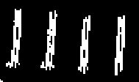
Line information
Y1
X2
line 1
. . .
. . .
. . .
. . .
line n
GX for vertical line
X1
Y2

Slide 10

Line information
column1 2 ...... n
GY or horizontal line

Slide 11
Step4: pseudocode
Algorithm#1: record X1,X2,Y1,Y2
for i = 1 to height of image
for j = 1 to width of image
if Label(i,j) is labeled
index = Label( i, j )
if whetherlabelx(index)==0//no check before
X1= j;
Y1= i;
whetherlabely(index) = 1 ;
if whetherlabely(index) == 1
if j<X1
X1 = j
else if j>X2
X2 = j
Y2 = i

Slide 12
Algorithm#2: calculate the mode width and length
e.g for GX
max_x = max width of components in GX
modex = zeros(1,max_xwidth);
for i = 1 to labelnumx
if width(i)>0
modex(width(i) ++;
normalwidthx = 0
for i = 1 to max_x
if mode(i)>normalwidthx
normalwidthx = i;
end
similiar way to count normalwidthy
modex example
normalwidthx = 7 in this image

Slide 13
Step 5: Remove width and height is not like a line
Because line-components appear most in the picture(after removing noise in stage 3, we have remove many noises). We statistic that the width and length that appears most by checking the list of recordlabel
and that is the round width and length of a parking line.
width>1.5normalwith or hight<3/4normal height or >3/2 normal height
remove the component whetherlabel(index) = 0

Slide 14
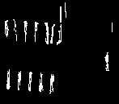
Step 6 :Remove some line-like components
There are some lines seperated can not be considered to a parking line.

Slide 15
Algorithm#3 how to check line-like components not a line
for i = 0 to labelnum
if whetherlabelx == 1 //is a component left in present image？
if Ischecked== 0 // no checked label
Ischecked=1 // has checked the label
cx = centerx(i), cy = centery(i)
countback = countwhite = 0
while countback >5normalwidth && not over the boundary
index = label(cy,cx)
if index~= 0// is not black
if countback >2normalwidth && label(cy,cx)!= i
countx++;
Ischecked(index) = 0;
Isline(i) = Isline(index) = 0;
countblack = 0 ;
countwhite ++;
if index == 0 //is black
countwhite = 0;
countblack++;
cx++; //move one right pixel
end
it is the same way to check one's left line by change cx++ to cx--

Slide 16
if we find label refer to this component
①
①
②
use 2 variable countwhite and countblack.
If meet black countblack add 1 and countwhite turn to 0
if meet white judge if countblack is over 2 times normal line width
if so thought here is a parking lot and the next line and former line is a parking lot
then turn countblack to 0 and turn countwhite add 1

Slide 17
Results: Demo & Evaluation
This is our input image comes from the Google Map

Slide 18
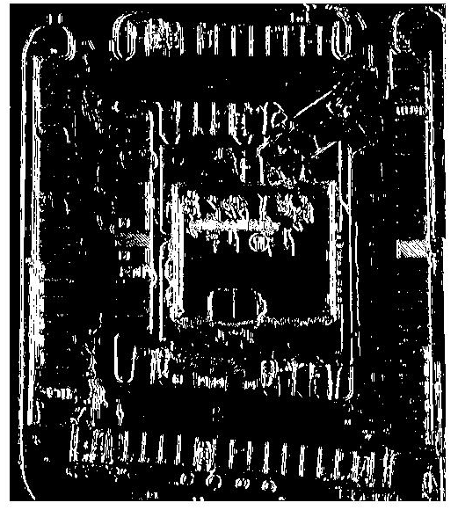
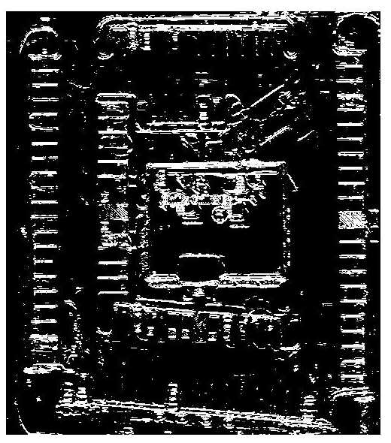
Results: Demo & Evaluation
After step1, we get x and y direction image.
Gx Gy

Slide 19
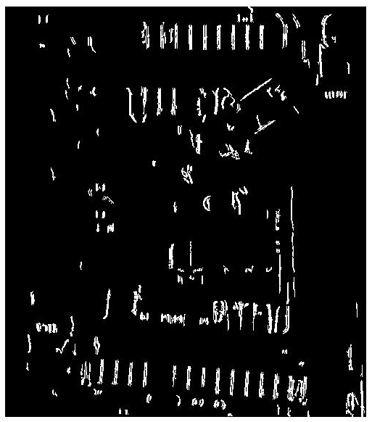
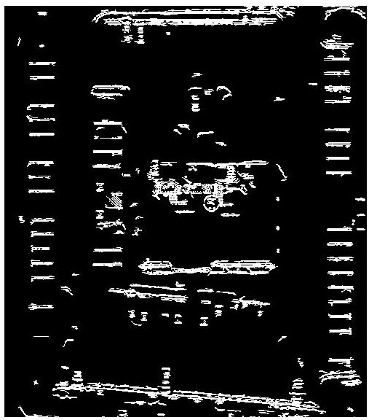
Results: Demo & Evaluation
After step 3, we get first time remove noise image
Gx
Gy

Slide 20
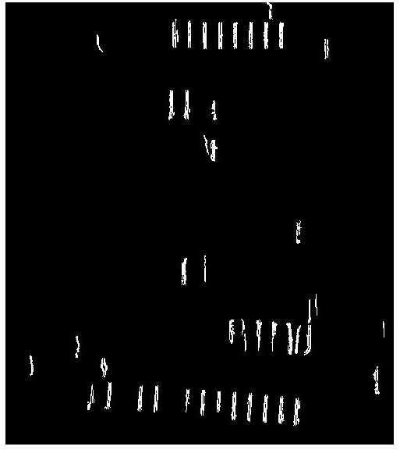
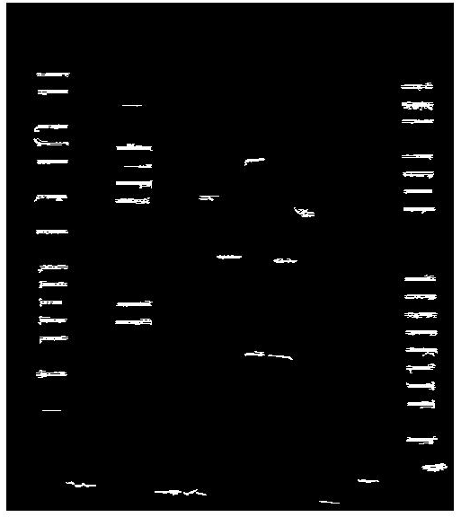
Results: Demo & Evaluation
After step 5, we keep all line-shape image.
Gx
Gy

Slide 21
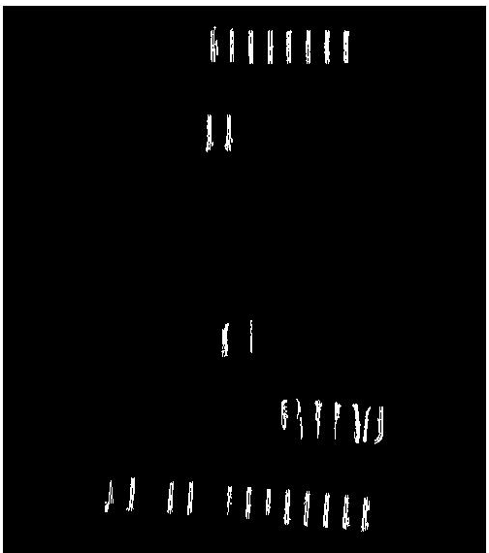
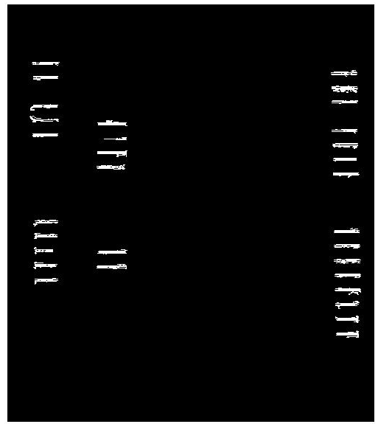
Results: Demo & Evaluation
After step 6, we keep all parking lines.
Gx
Gy

Slide 22
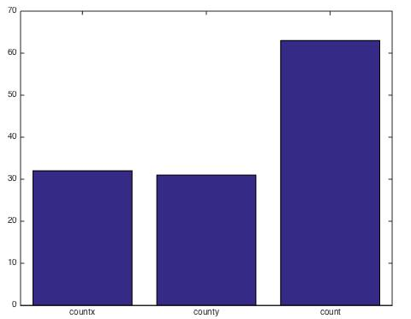
Results: Demo & Evaluation
Final statistics
Total number
Gx line
Gy line

Slide 23
Summary & Future Work
We basically accomplished all of our goals. We remove all the objects not a parking line and remain most available parking lines.
The cost time is only width * height of the image. So we can process it very fast. That's feasiable.
Shortcome
1.We do not check some lines that was coverred by a car. Like this:

Slide 24
2.Can not check diagonal parking line. Nowadays, we can only check horizentaland vertical lines.
Future work: We can apply it in the Google Map. It can show how many parking lots in a parking lot. It can show the statistics of parking lots every hours. It is an effective infomation for department of traffic and construction. They can show guide that which space is lacked of parking lots and when it is lacked parking lots to make a good decision to guide traffic and do construction of parking lot.
Appendix: assignment#2 and assigment#4 in DIP course. The other algorithm is created by ourselves.

